Slide 1
Static VAR Compensator
It is a FACTS devices.
It is used as a Capacitor Compensator or an Inductor Compensator.
General architecture of Static VAR Compensator as shown in Figure below.
There is transmission line, in which sending end voltage and receiving end voltage.
Connected by Step down Transformer.
Input of Send End Voltage is connected to the Primary of the Transformer.
Secondary of T/F is to connected with TSC (Thyristor Switched Capacitor) in which number of Thyristors are connected antiparallel directions.
Similarly, secondary of T/F is also connected with TCR (Thyristor Control Reactor) in which number of thyristor connected in antiparallel directions.
The Gating is controlled by this Controller, which has I/P parameter Setting by changing the Thyristor conducting angle to compensate the voltage.
Voltage is coming in the Potential T/F as a Fixed Voltage, in controller changing the conduction angle of the Thyristor to take the action Inductor or capacitor compensator.

Slide 2
Static VAR Compensator
Static means SVC has no moving parts such as circuit break’s and disconnects.
SVC provide the reactive power on the transmission networks.
When the voltage at a bus falls below the reference value, then Capacitive VARs to be injected.
On the other hand, when the bus voltage becomes higher than the reference value, then inductive VARs are supplied to lower the bus voltage.

Slide 3
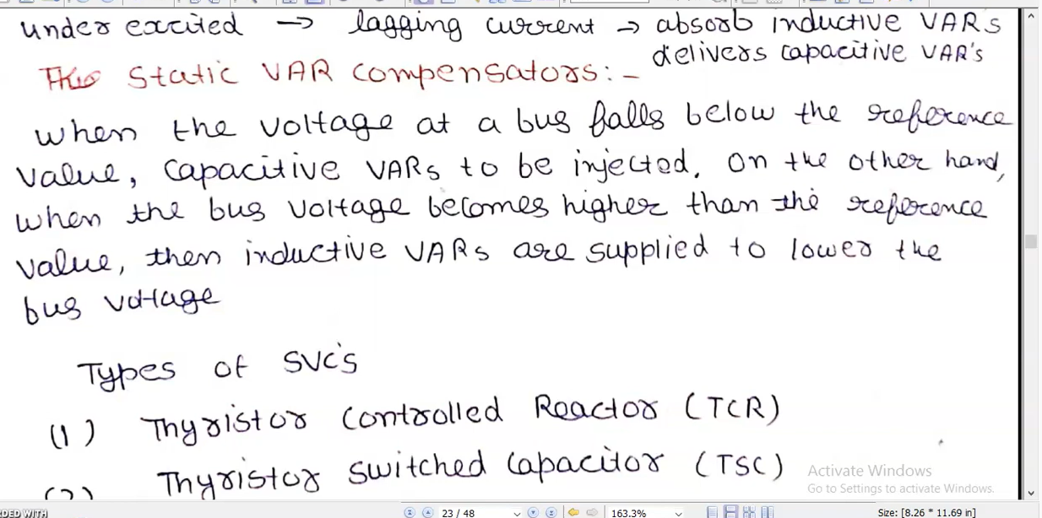

Slide 4
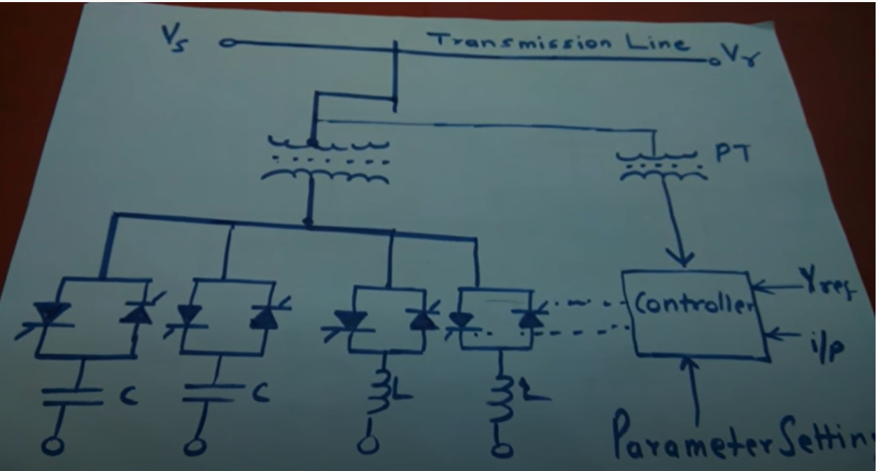
Step-down T/F
Potential T/F
TSC
TSR

Slide 5
STATCOM
It is the advanced VAR Compensator.
It is used as a voltage source converter.
It has Settings and controller I/P.

Slide 6
Types of Static VAR Compensators (SVC’S)
Thyristor Controlled Reactor (TCR)
Thyristor Switched Capacitor (TSC)
Fixed Capacitor (FC)-Thyristor Control Reactor.

Slide 7
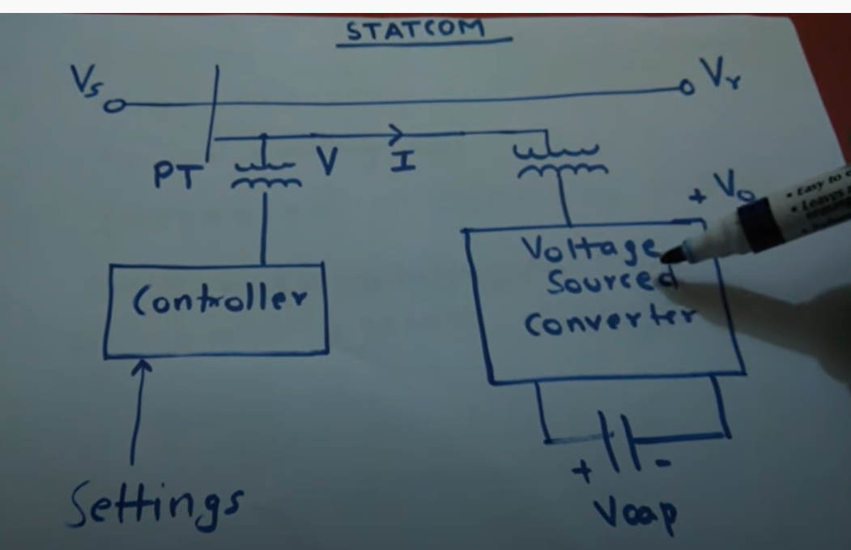
STATCOM

Slide 8
Features of STATCOM
Wide operating range.
Lower rating for stability.
Increased transient rating.
Better capability to handle dynamic system disturbance.

Slide 9
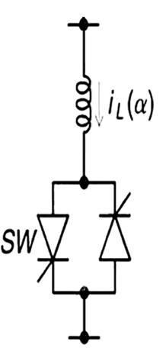
Thyristor Control Reactor (TCR)
It is the basic building block of SVC (Static VAR Compensator).
TCR is used to absorb the excess reactive power in the system.
It is normally used with Thyristor Switched Capacitor (TSC), to provide the controlled reactive power generation.
Single-phase Thyristor Controlled reactor (TCR) is consists of a fixed reactor of inductance L, and bidirectional thyristor switch or valve.
It is a shunt device to control the current depending on the switching angle of the thyristor.
Currently available thyristors have 4KV to KV voltage rating.
Current rating is 3 KA to 6 KA.
To meet the required blocking voltage and current in real power system, the series and parallel connection of thyristor is used.

Slide 11
Advantages of Thyristor Control Reactor
It can block very high voltage.
It has High voltage rating.
It has high current rating.

Slide 12
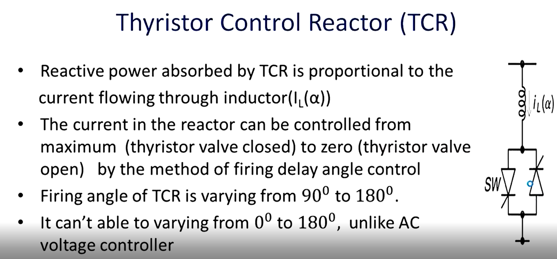

Slide 13
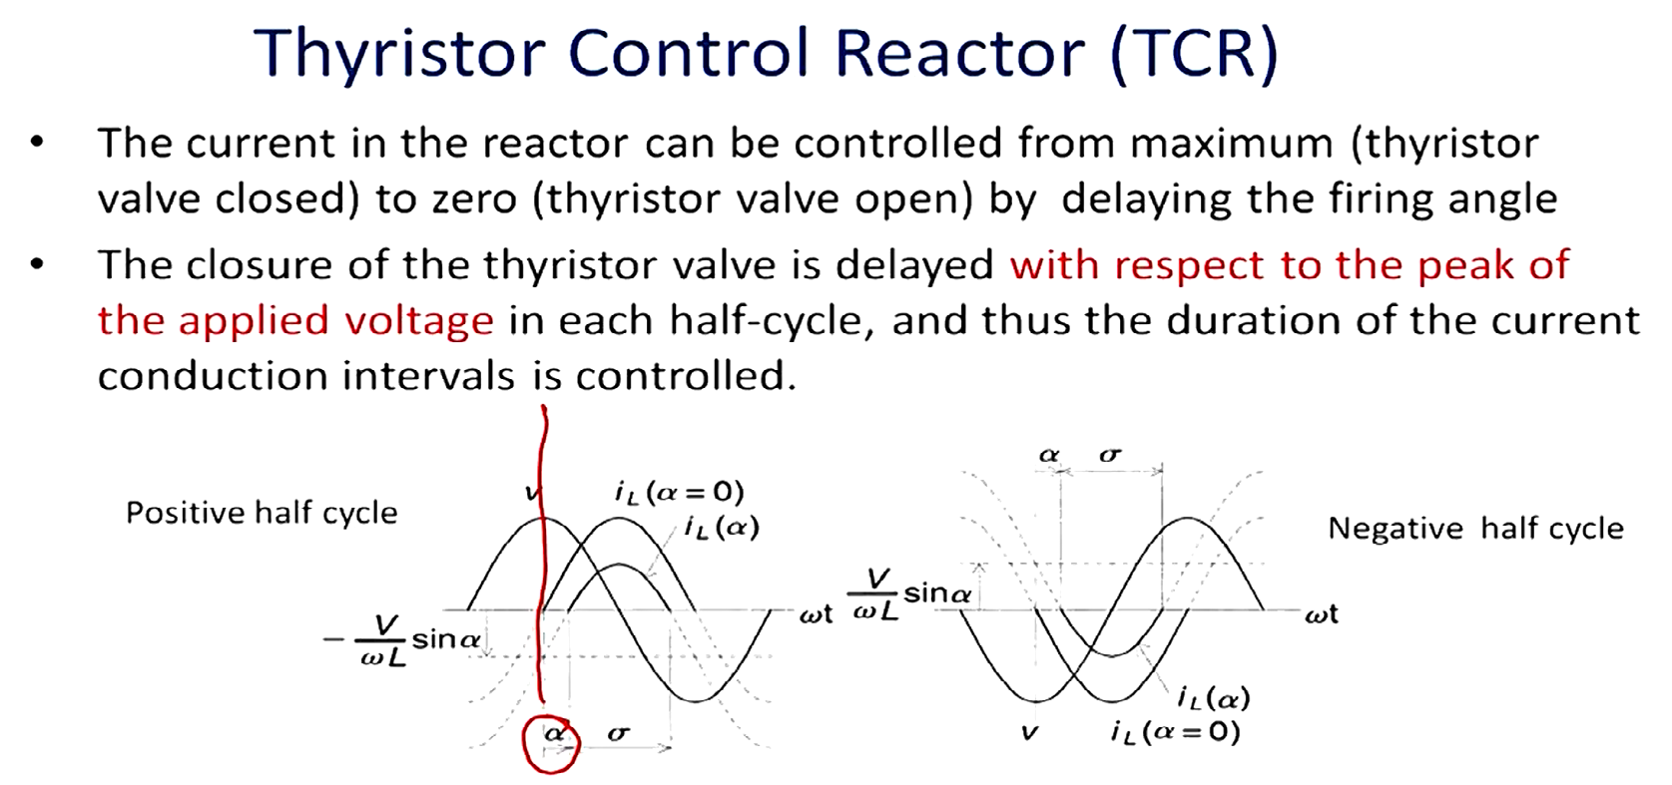

Slide 14
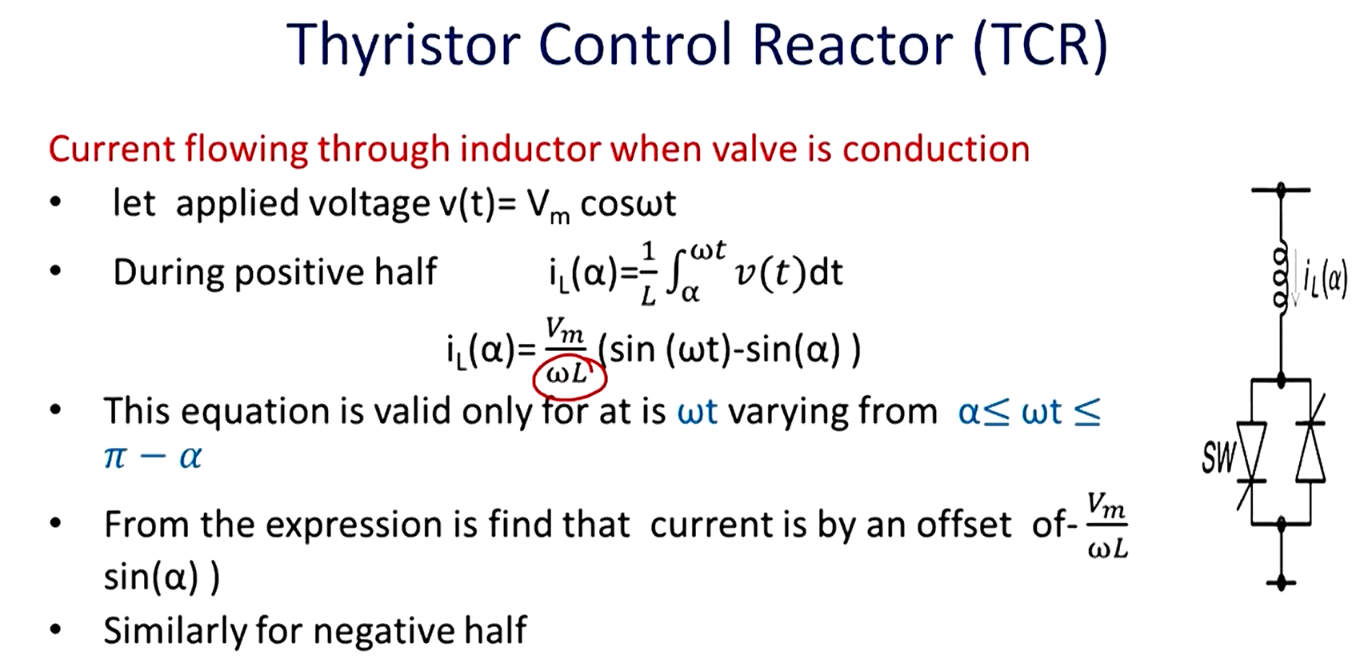
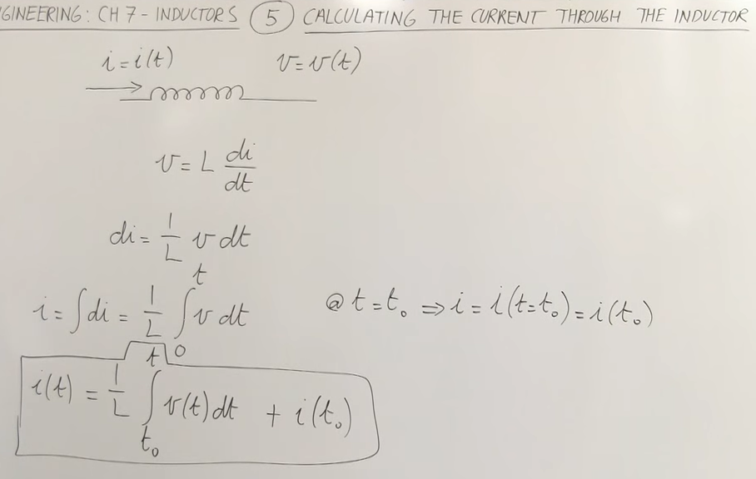
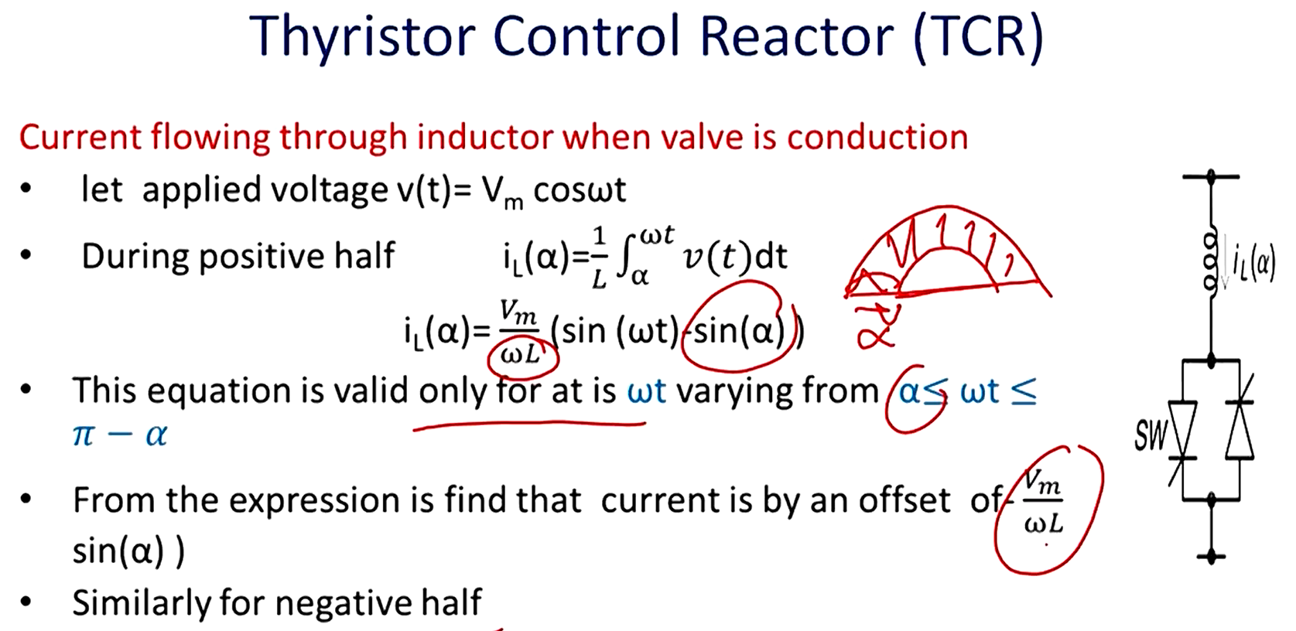

Slide 15
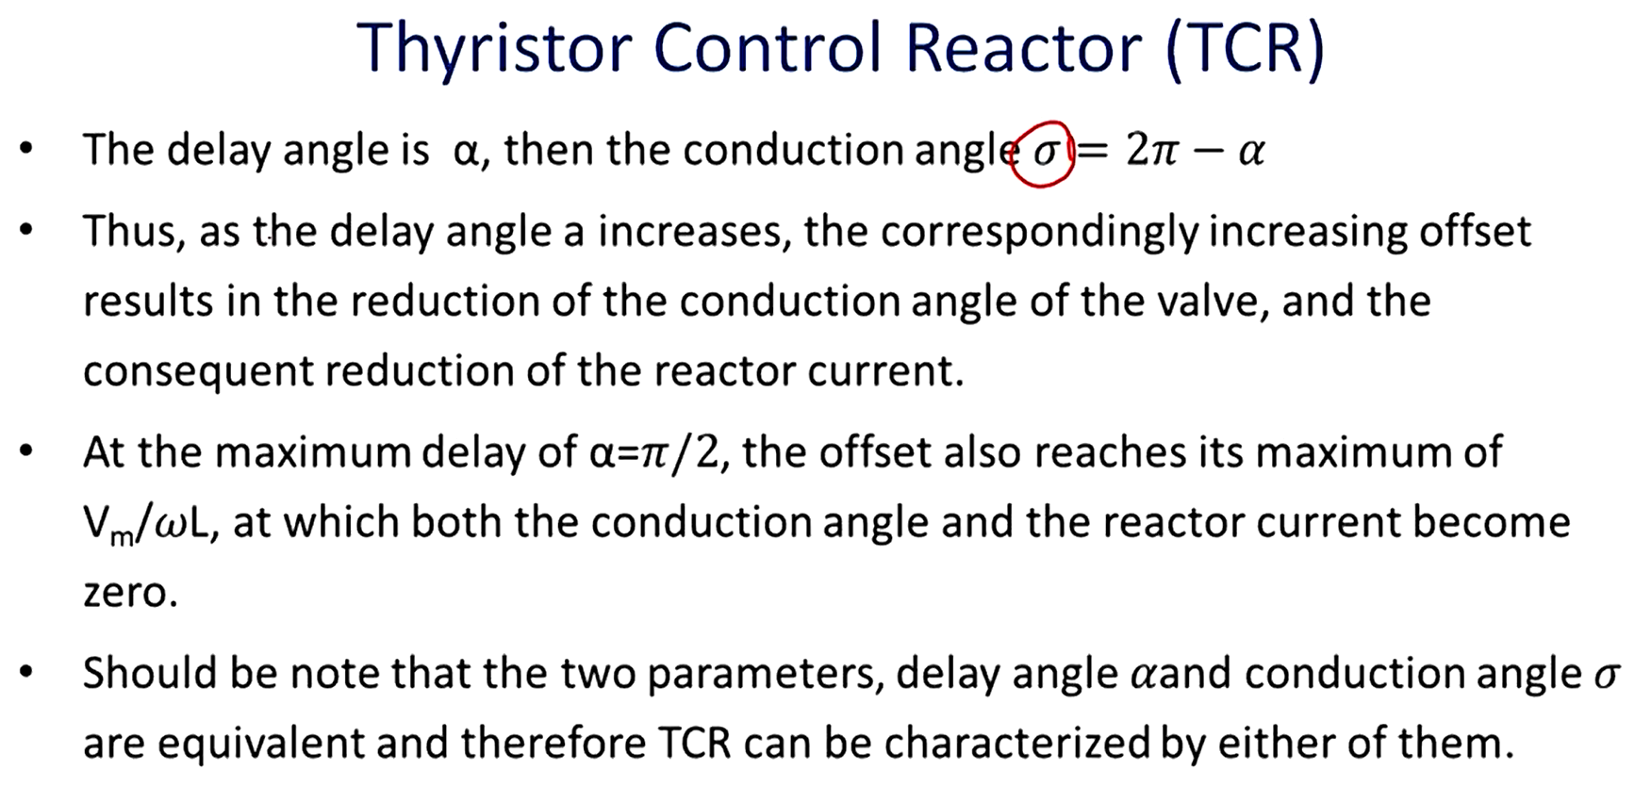

Slide 16
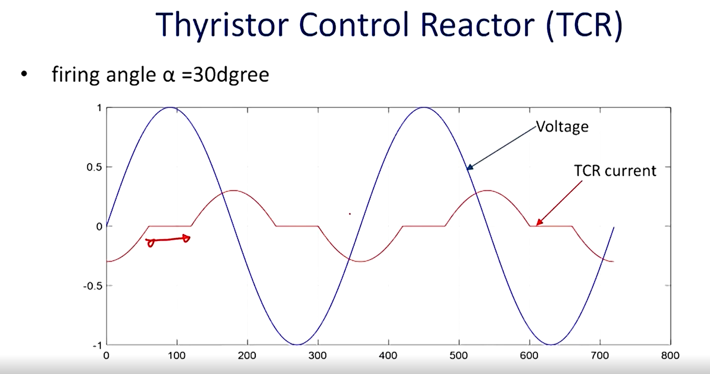

Slide 17
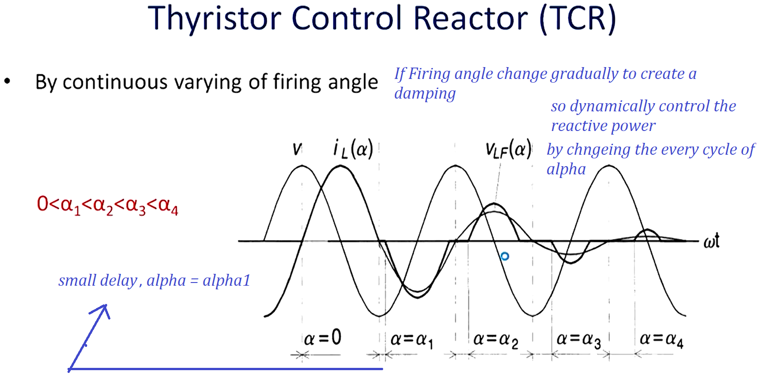

Slide 18
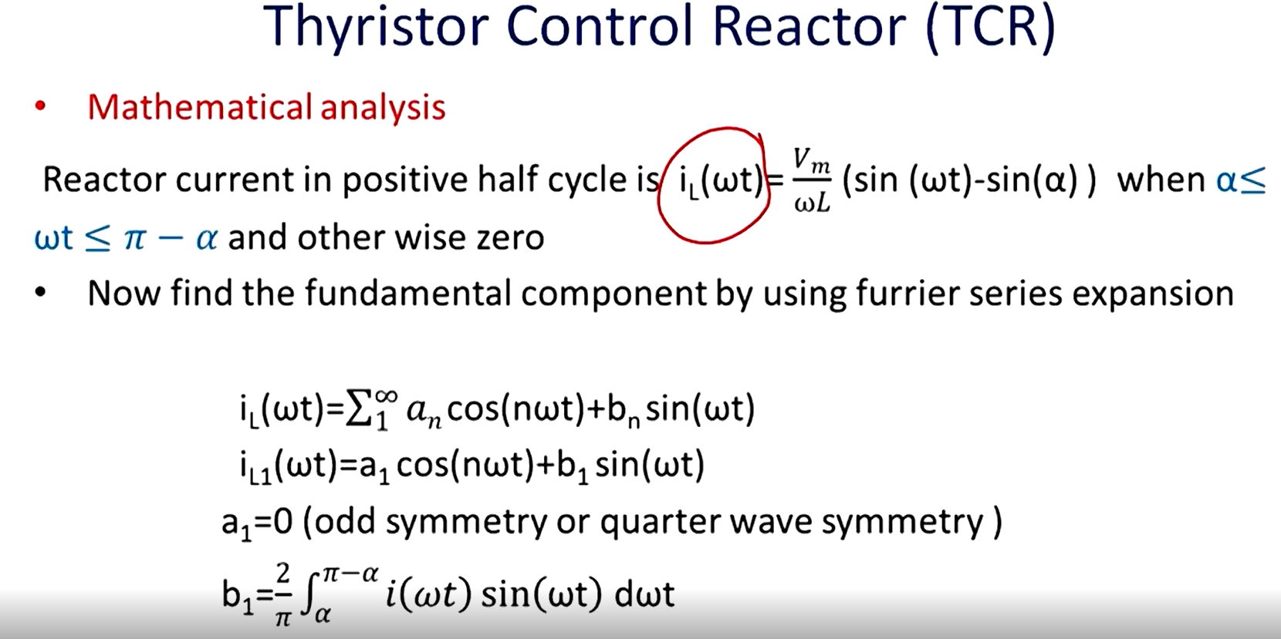

Slide 19
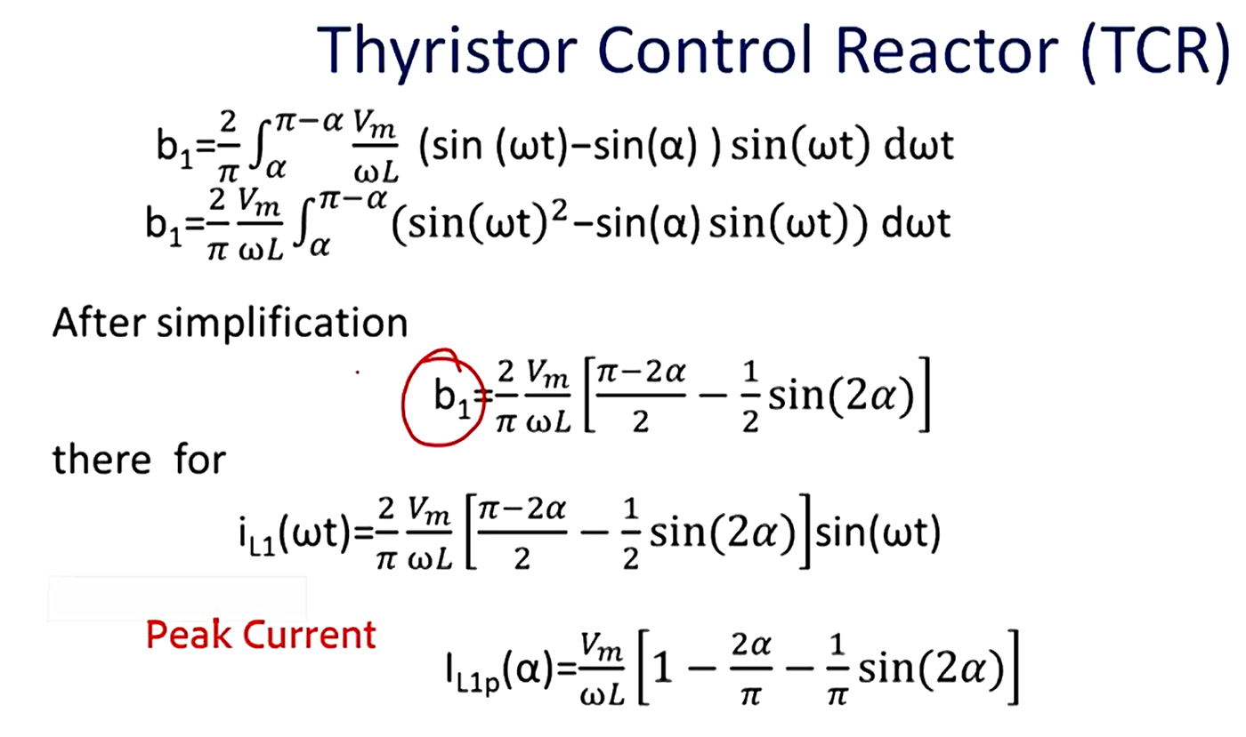

Slide 20
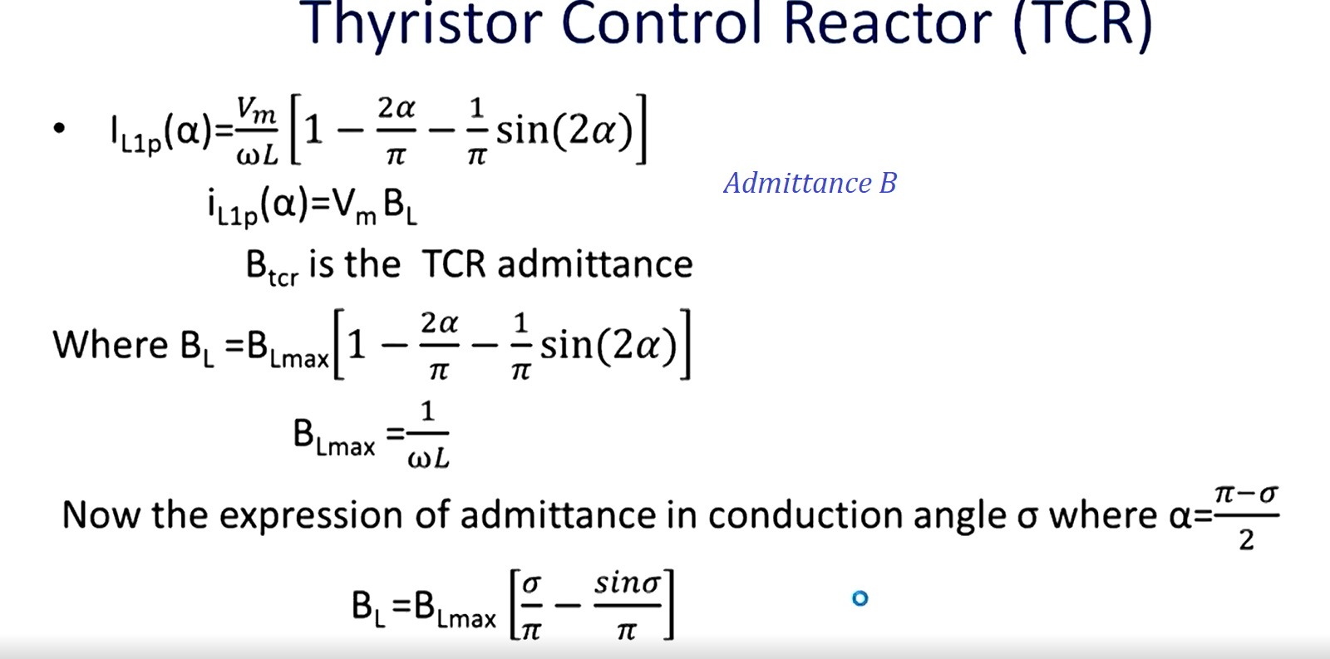

Slide 21
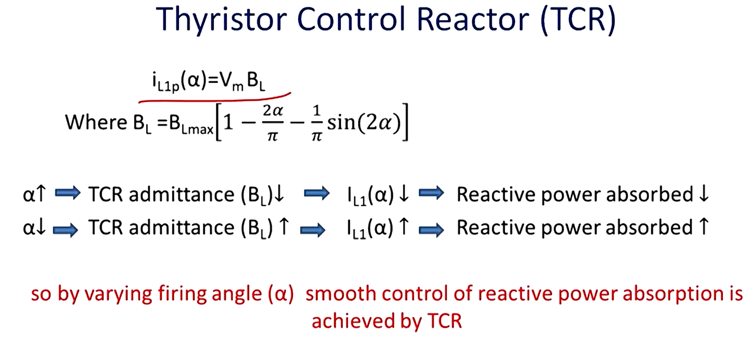

Slide 22
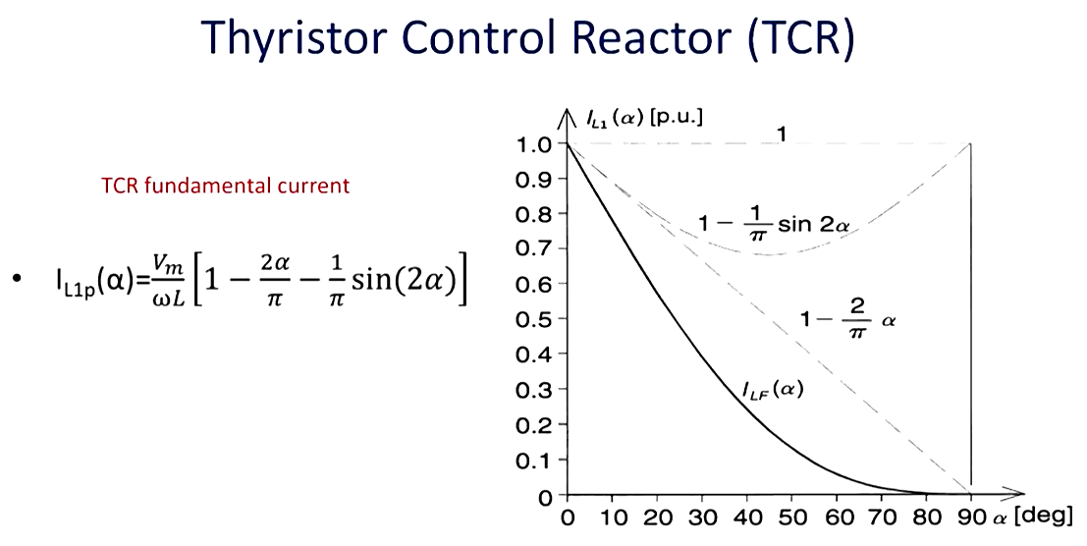

Slide 23
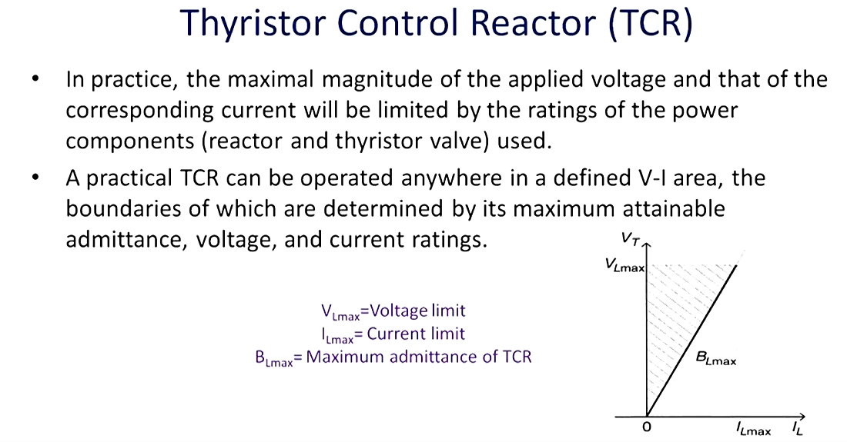

Slide 24
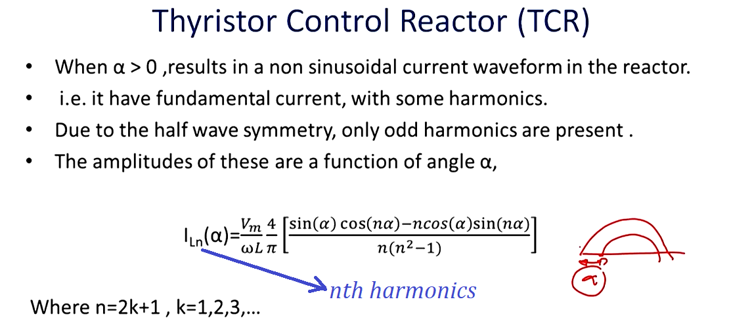

Slide 25
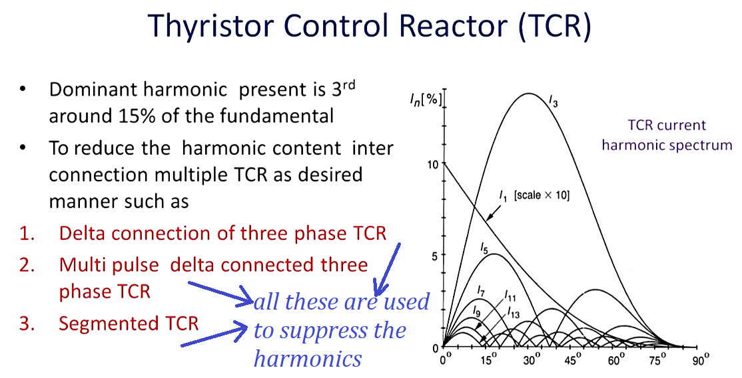

Slide 26
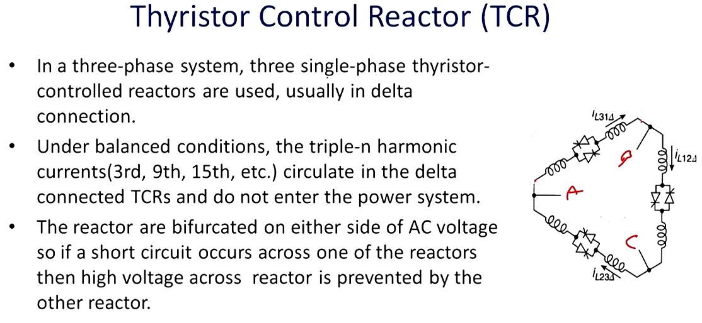

Slide 27
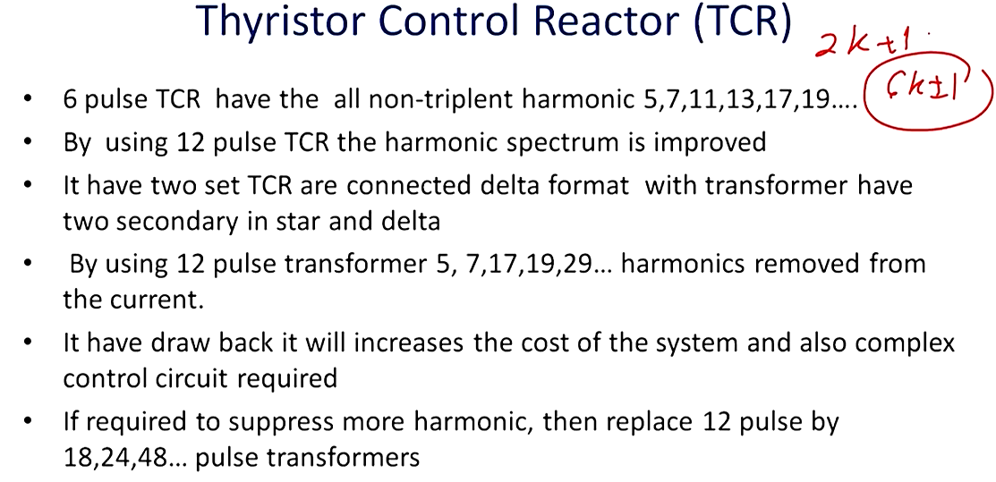

Slide 28
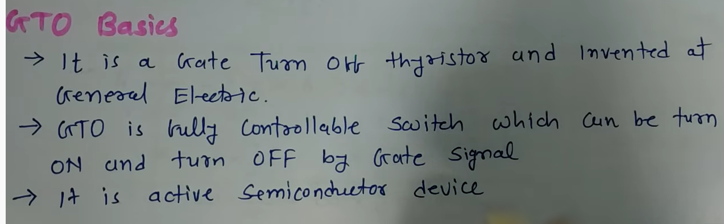
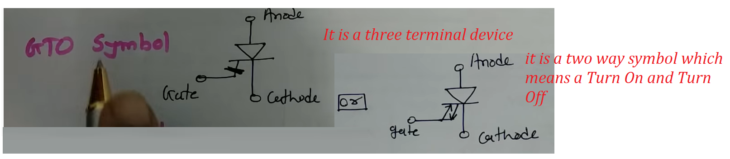
GTO is 10 times faster than SCR

Slide 29
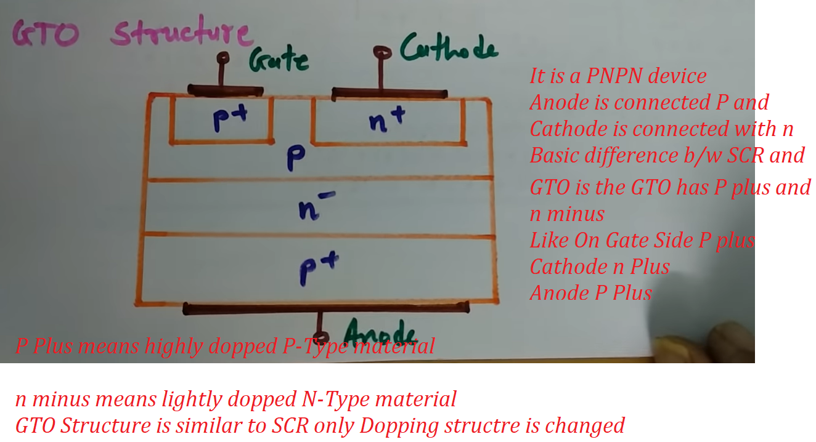

Slide 30
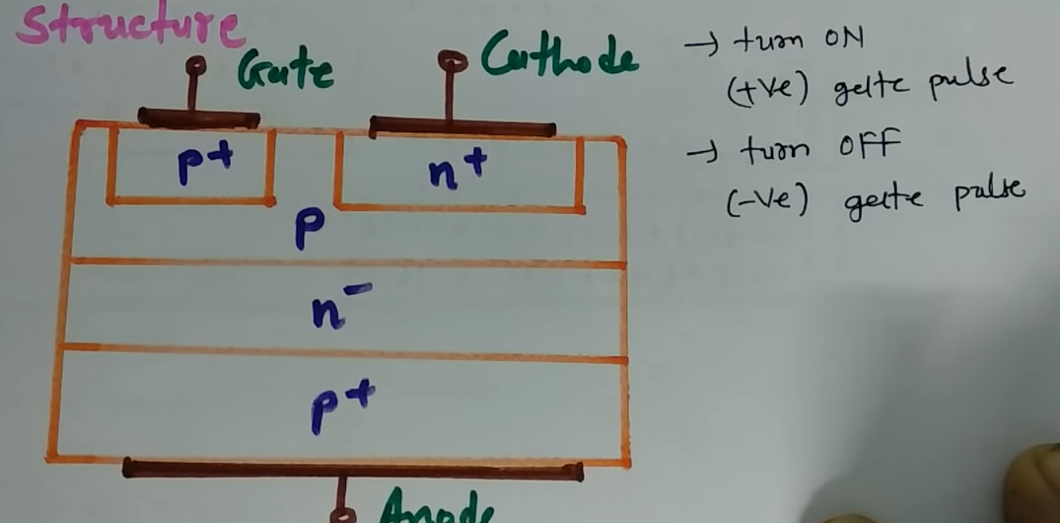

Slide 31
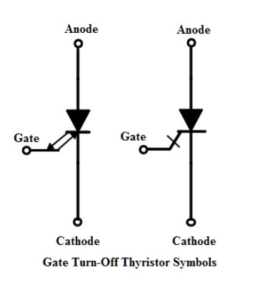
Symbol of GTO

Slide 32
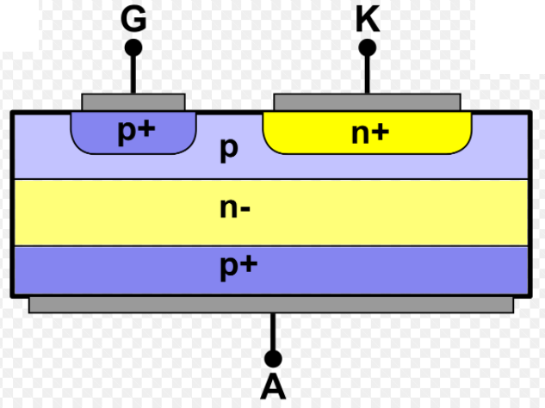
Structure of GTO

Slide 33
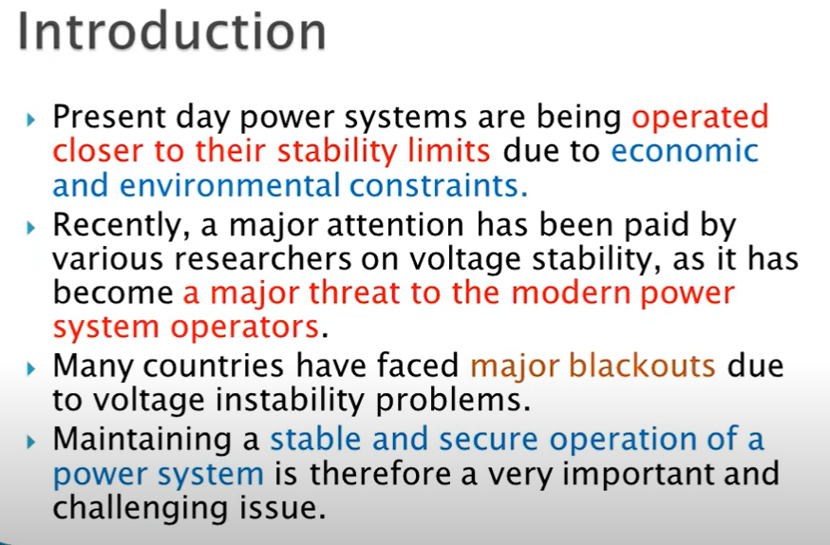
Voltage Stability

Slide 34
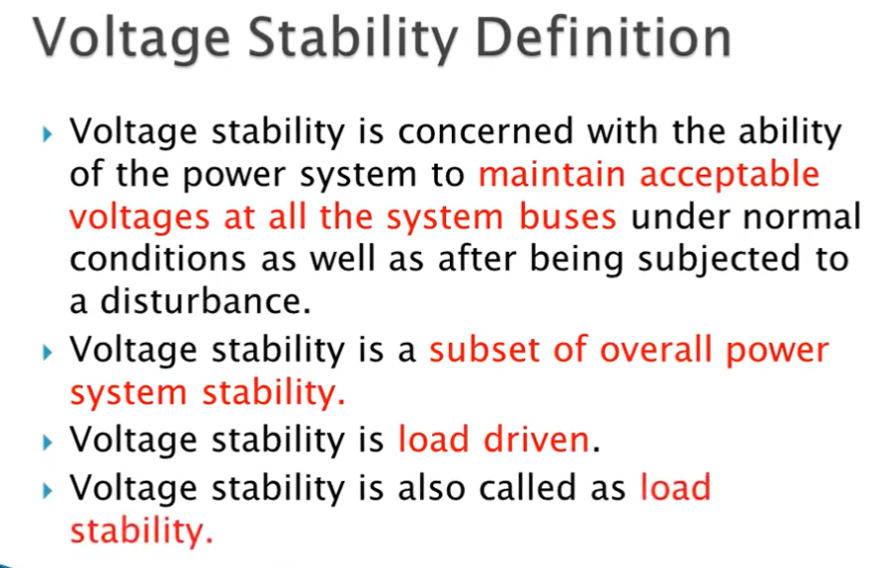

Slide 35
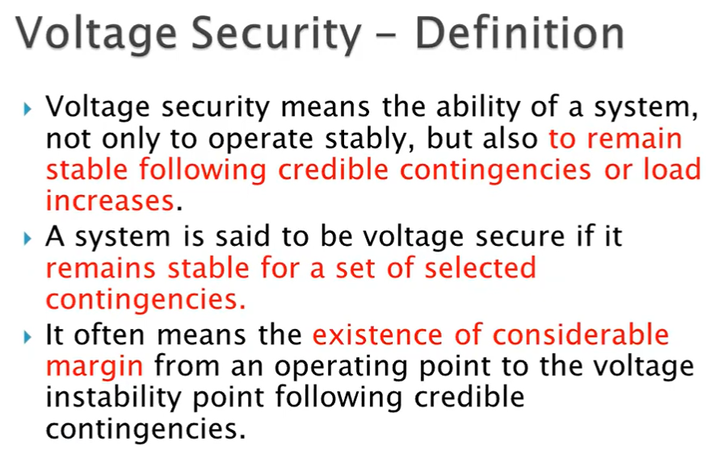

Slide 36
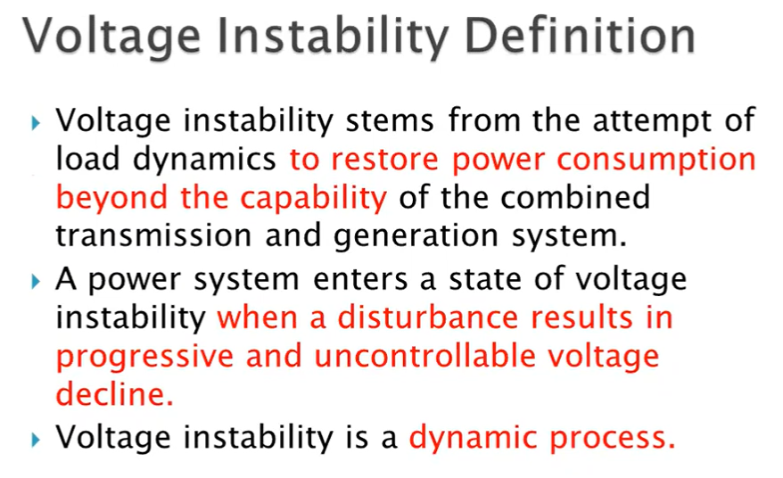

Slide 37
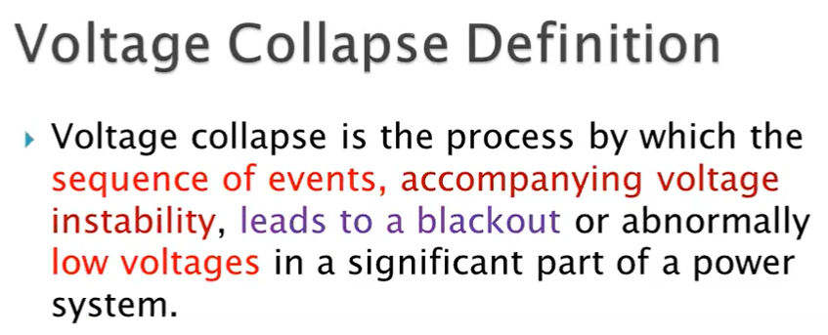

Slide 38
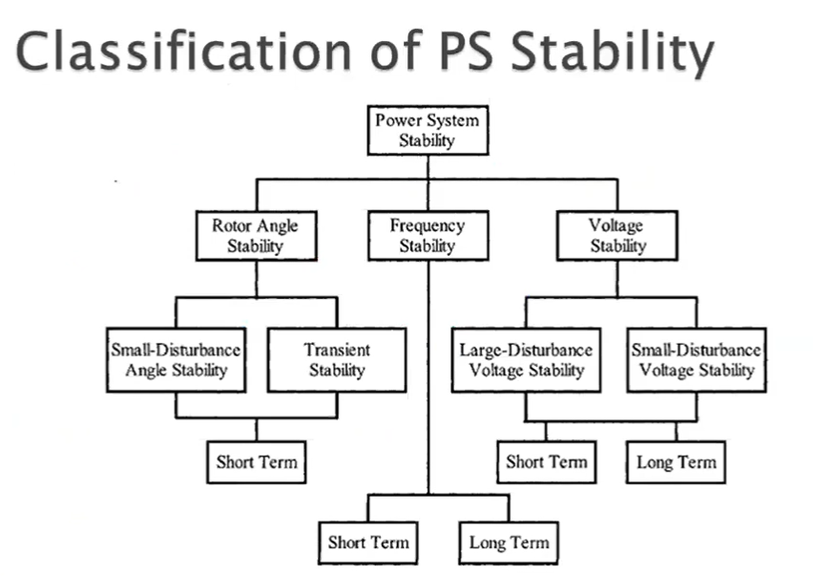

Slide 39
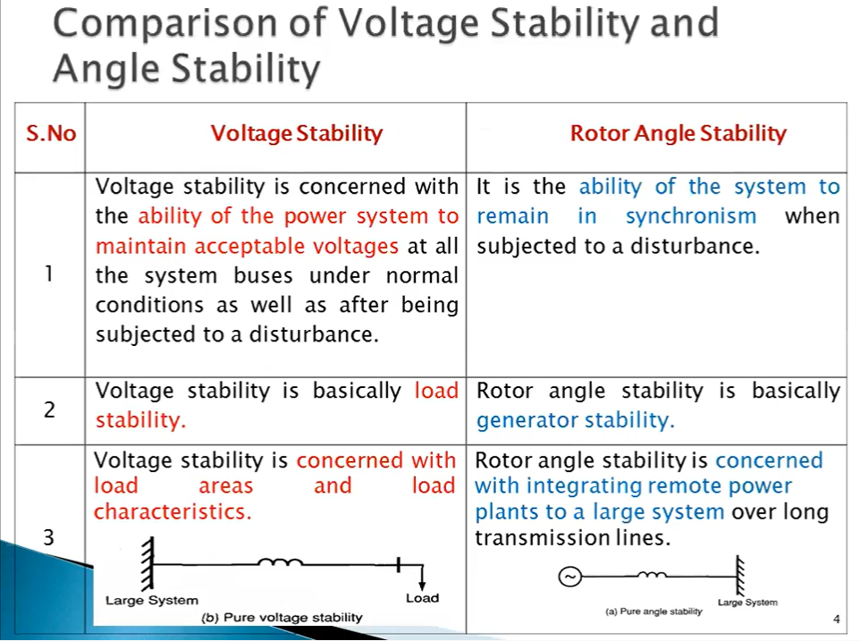

Slide 40
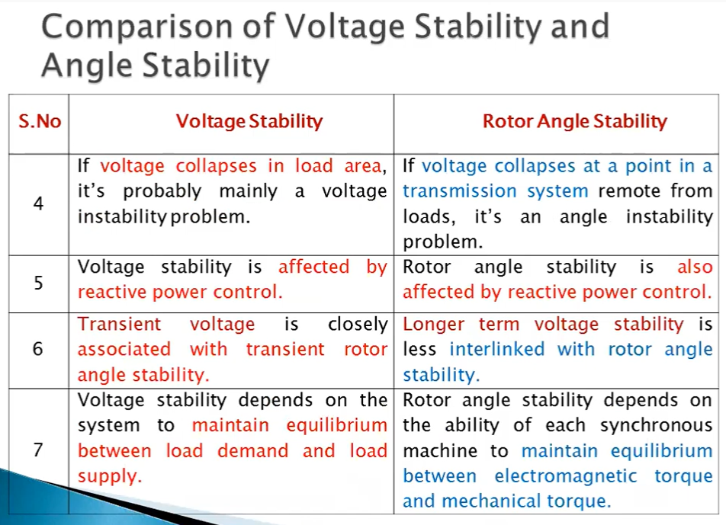

Slide 41
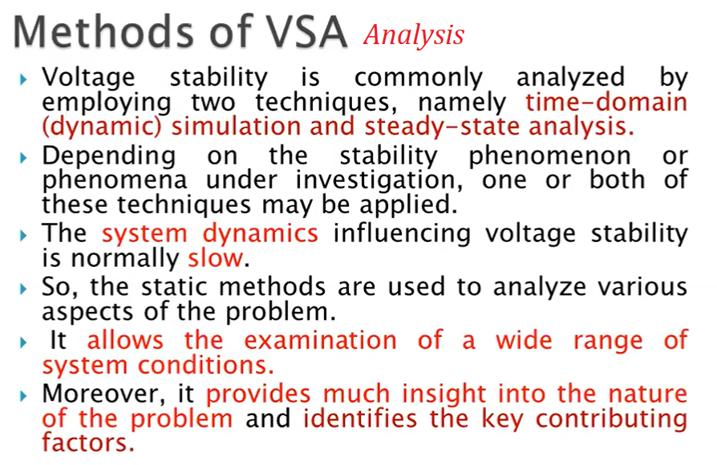

Slide 42
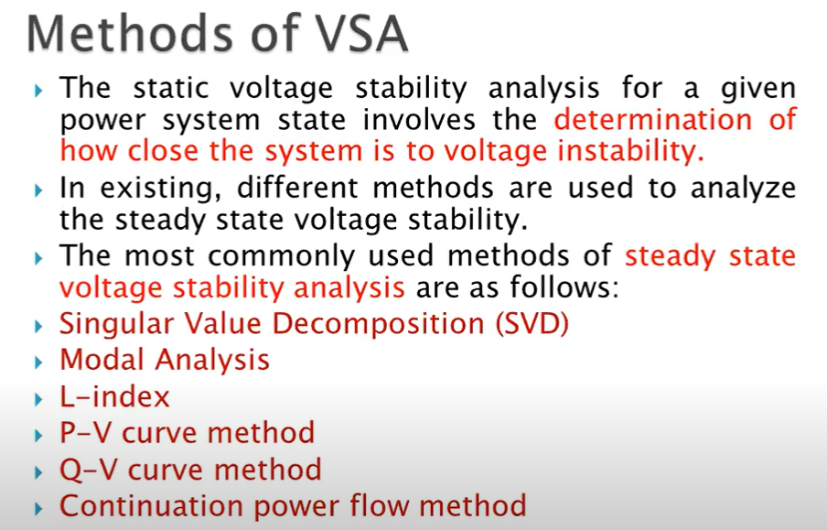

Slide 43
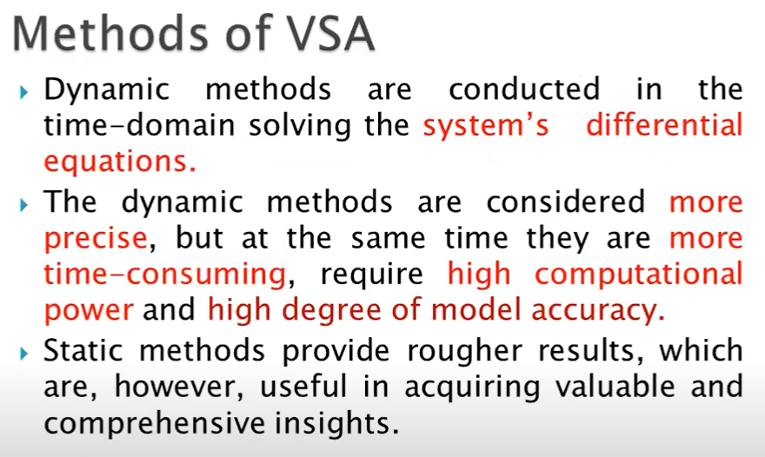

Slide 44
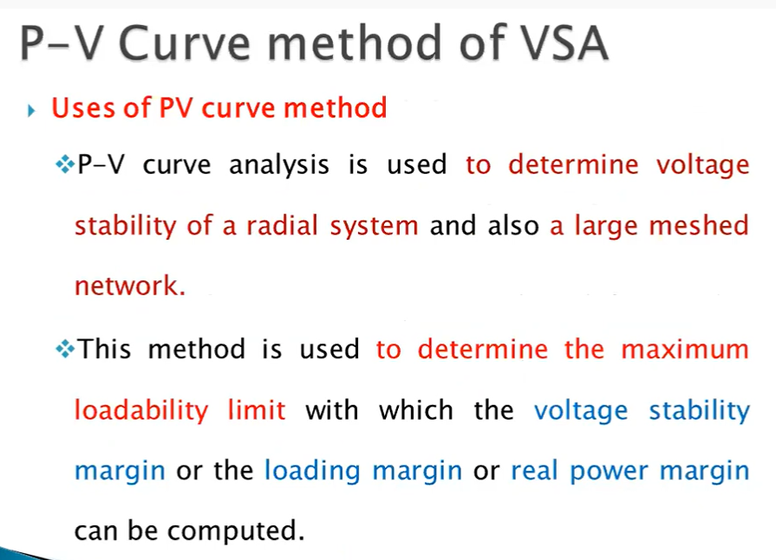

Slide 45
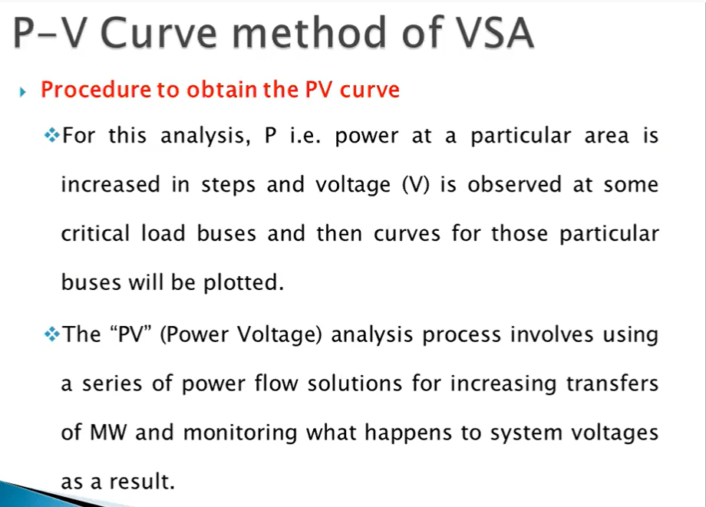

Slide 46
